Slide 1
Label Propagation Algorithm
Course Project CSE655
Group 5
Vimansh Mahajan
Shrutya Chawla
Prakhar Gupta
2022572
2022487
2021550

Slide 2
Resources
Research Paper
Near linear time algorithm to detect community structures in large-scale networks
Graphs/Networks
Zachary’s Karate Club: Nodes = 34 Links = 78
Co-Authorship Network: Nodes = 23,123 Links = 93, 497
WWW Network: Nodes = 3,25,729 Links = 14,97,134

Slide 3

Metrics
Modularity: Measures how well a network is divided into communities. Range: [-1,1]
Jaccard: measures how many node pairs, occur in same community over different iterations, is a node level metric. Range: [0,1]
Fsame: How well the predicted communities overlap over different iterations, is a community level metric. Range: [0,1]

Slide 4
Deliverable 1: Scratch LPA Implementation
Initialization
Assigns each node a unique label (typically its node ID).
Label Propagation Process
Iteratively updates each node's label to the most frequent label among its neighbors.
Randomly shuffles node order in each iteration to reduce bias.
Terminates when no label changes occur or after a maximum number of iterations.
Community Extraction
Groups nodes by their final labels to form detected communities.
Evaluation Metrics
Modularity (Q): Assesses the strength of community structure.
Jaccard Index: Measures similarity between node pairs across two clusterings.
fsame Metric: Captures community overlap from both source and target perspectives.

Slide 5
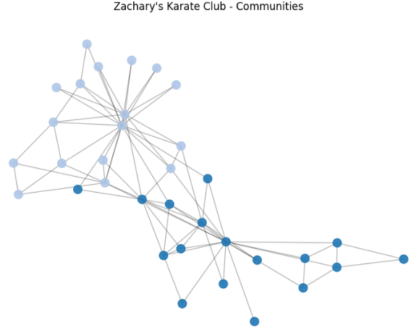
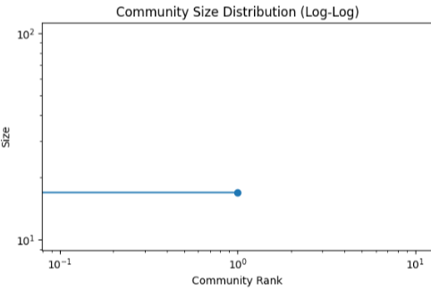
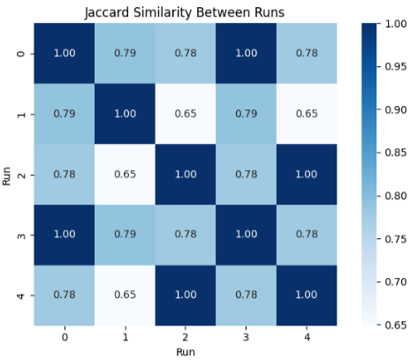
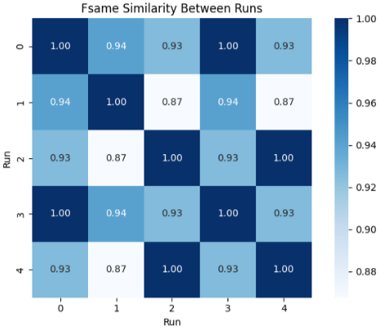
Zachary’s Karate Club (Q-Value: 0.3718)

Slide 6
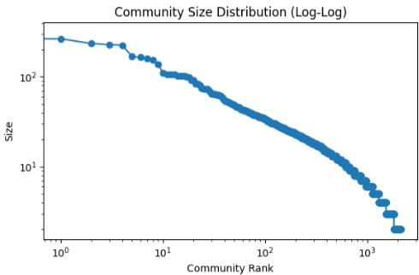
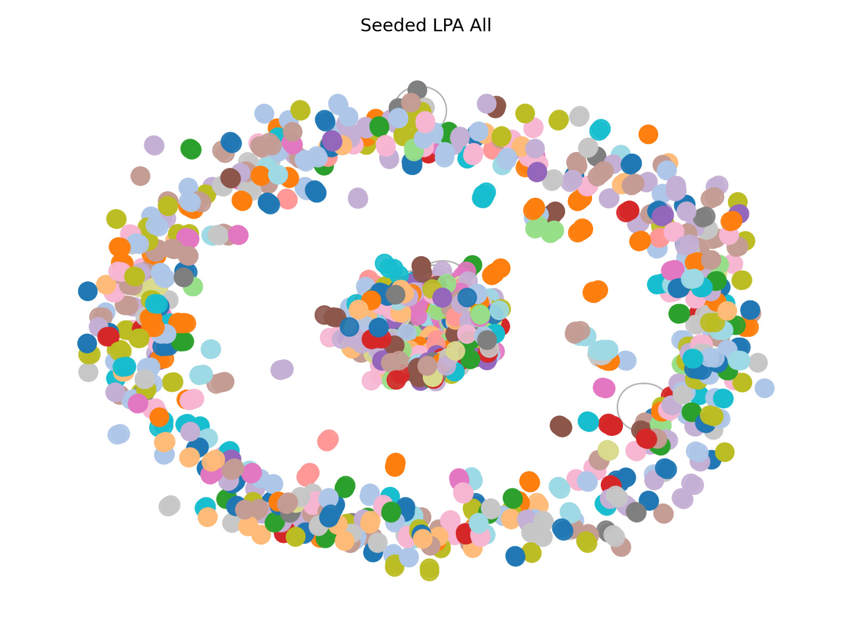
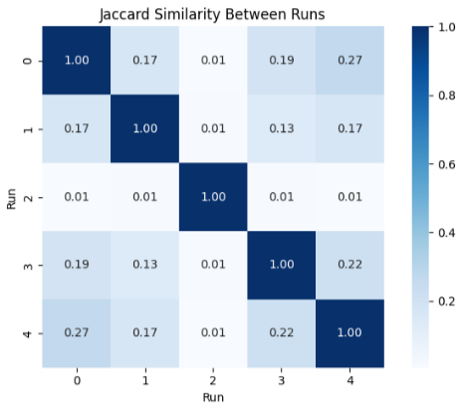
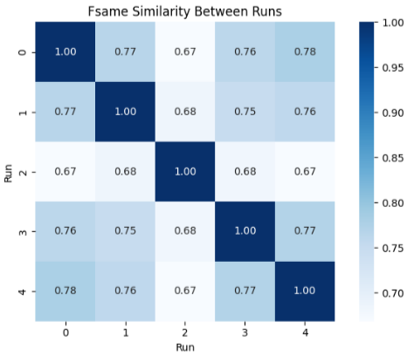
Co-Authorship Network (Q-Value: 0.6352)

Slide 7
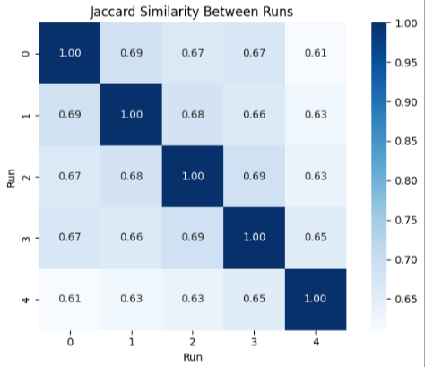
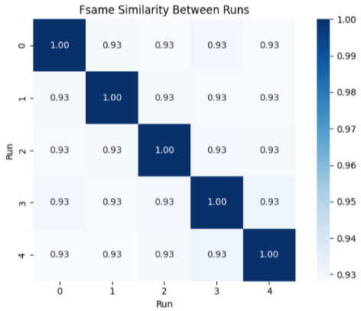
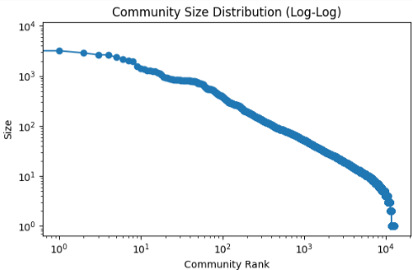
WWW Network (Q-Value: 0.8435)

Slide 8
Deliverable 2: LPA v/s Louvian
Louvain Algorithm – Key Points
Detects communities by maximizing modularity.
Works in two phases:
Move nodes to neighboring communities to improve modularity.
Group communities into super-nodes and repeat.
Produces a hierarchical (multi-level) structure.
Why Compare LPA vs Louvain?
Different Foundations: LPA uses label diffusion; Louvain performs greedy modularity optimization.
Efficiency vs. Modularity: LPA is faster (near-linear), but Louvain yields higher modularity.
Memory Efficiency: LPA is more memory-efficient than Louvian.
Determinism: Both are non-deterministic; Louvain tends to converge more stably.
Community Structure: LPA produces flat partitions; Louvain builds hierarchical communities.

Slide 9
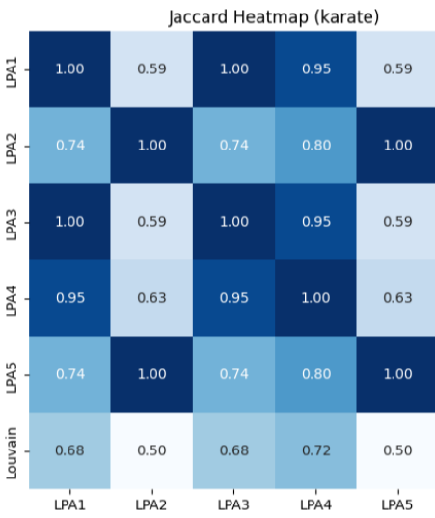
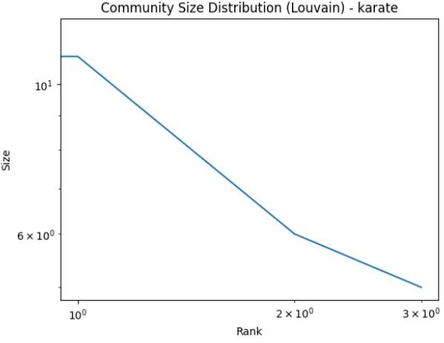
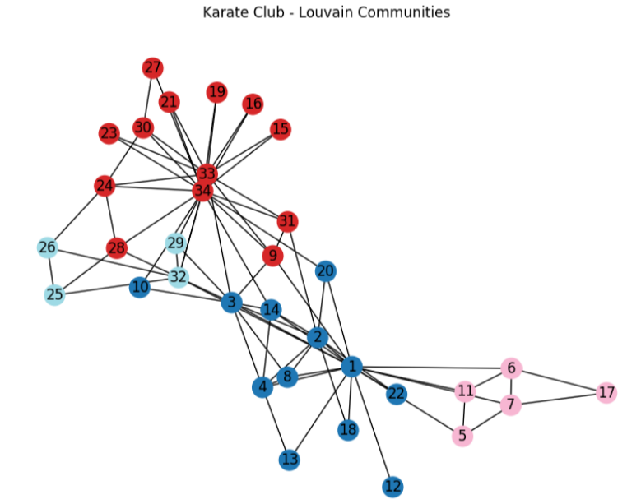
Zachary’s Karate Club (Lou. Q-Value: 0.4188)

Slide 10
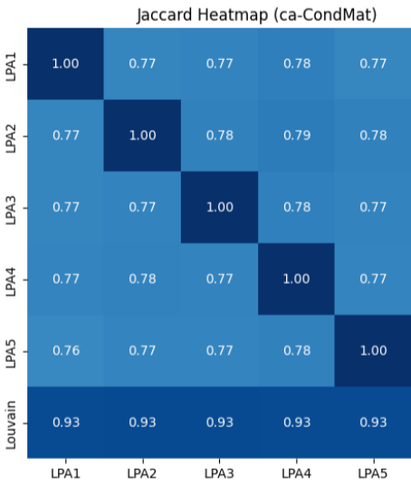
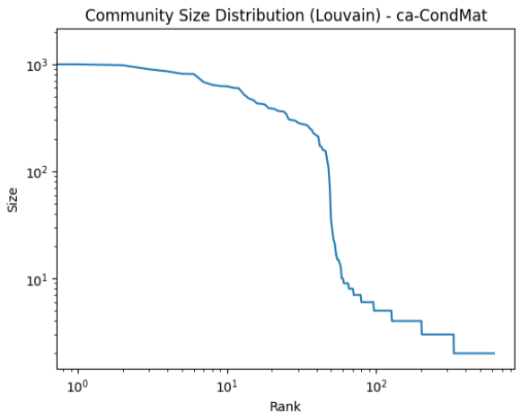
Co-Authorship Network (Lou. Q-Value: 0.7325)

Slide 11
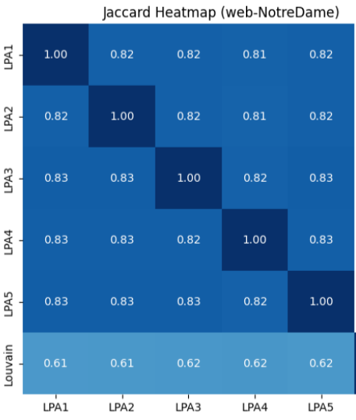
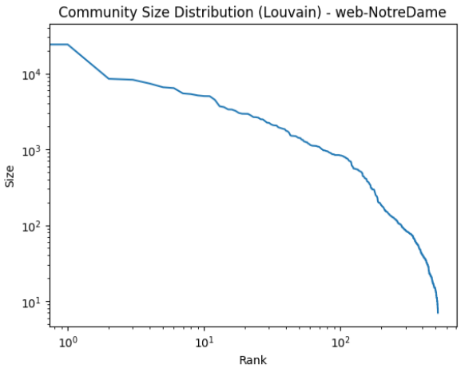
WWW Network (Lou. Q-Value: 0.9372)

Slide 12
Deliverable 3: Robustness To Noise
Introduce noise into the graphs using
Random Removal: delete a random edges.
Targeted Removal: remove edges that connect different communities
Methodology:
Re‐runs LPA on the perturbed graph.
Computes the new modularity and Jaccard index

Slide 13
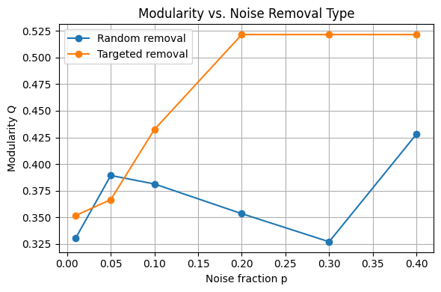
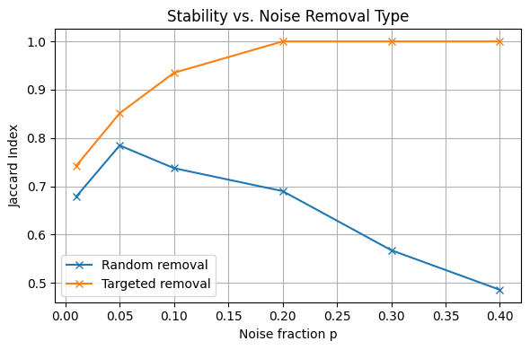
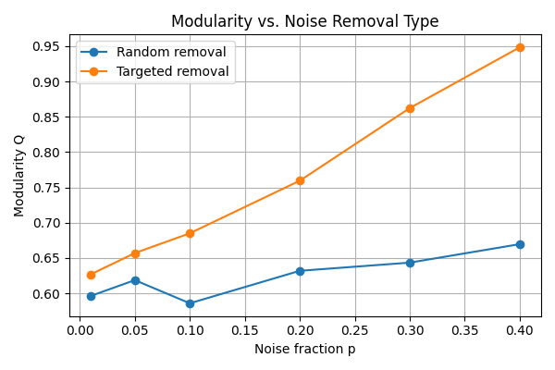
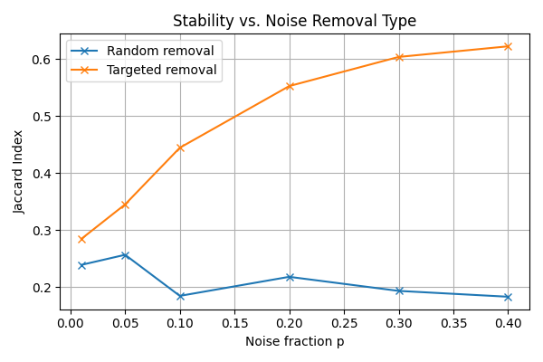
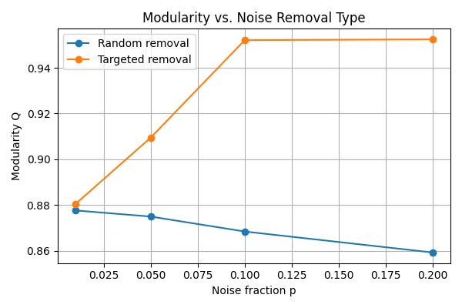
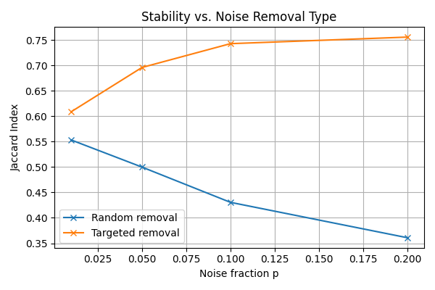
Deliverable 3 Results
Zachary | Random: Small uptick at 5 % then decrease in split quality and repeatability Targeted: Targeted removals deliver perfect stability (Jaccard → 1.0 by 20 % noise) and lift modularity (0.35→0.52).
Co-authorship | Random: Barely improves quality (~0.60→0.67) and highly unstable partitions (Jaccard falls to ~0.18). Targeted: raises modularity (~0.63→0.95) and stabilizes clusters (Jaccard ~0.28→0.62).
WWW | Random: deletions erode both quality (0.88→0.86) and stability (0.55→0.36). Targeted: Increases modularity (0.88→0.95 by 10 % noise) and increases reproducibility (Jaccard ~0.61→0.75).

Slide 14

Deliverable 4: GAE + K-means
Graph Auto-Encoder(GAE):
2 layer GCN encodes nodes into hidden space i.e. makes embeddings
Decoder reconstructs graph from embeddings
nodes in communities have similar embeddings
captures subtle patterns and global community signals better than raw adjacency methods.
K - Means:
cluster nodes according to embeddings
choose optimal clusters using silhouette score.

Slide 15
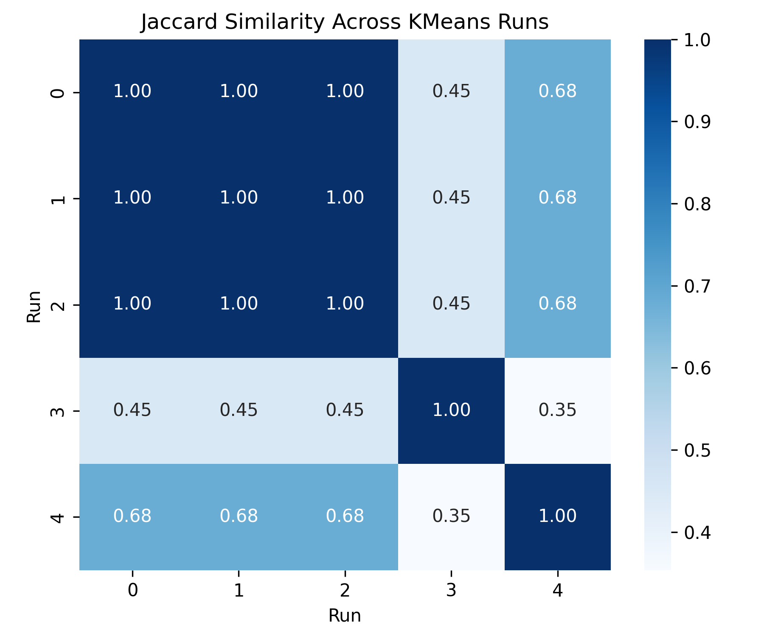
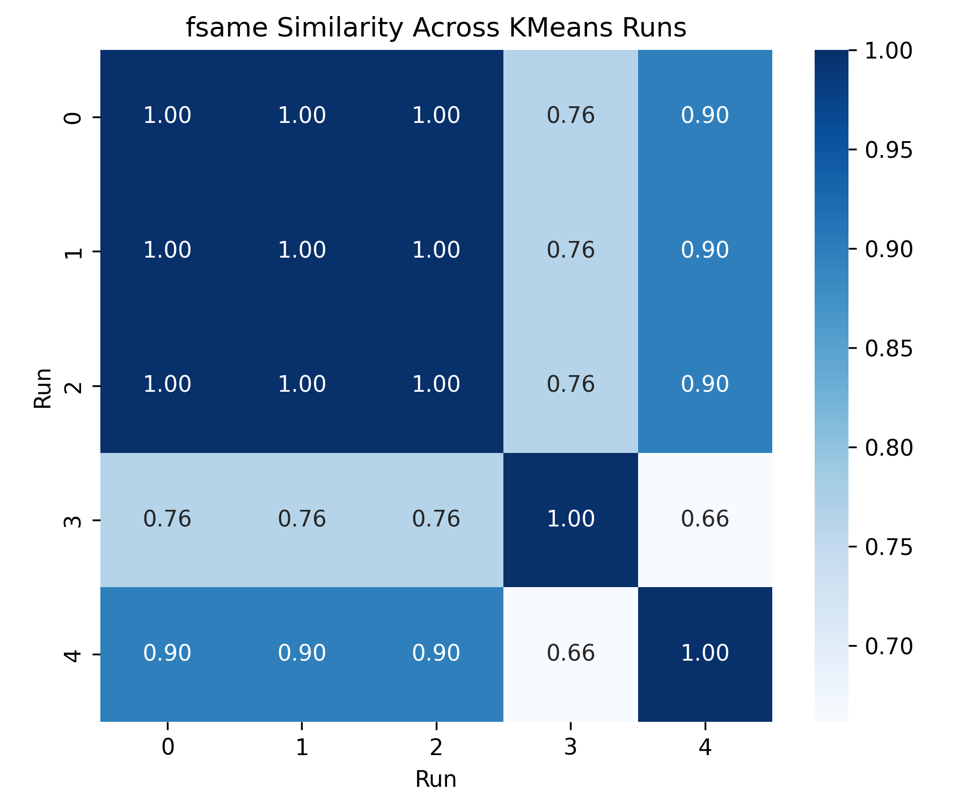
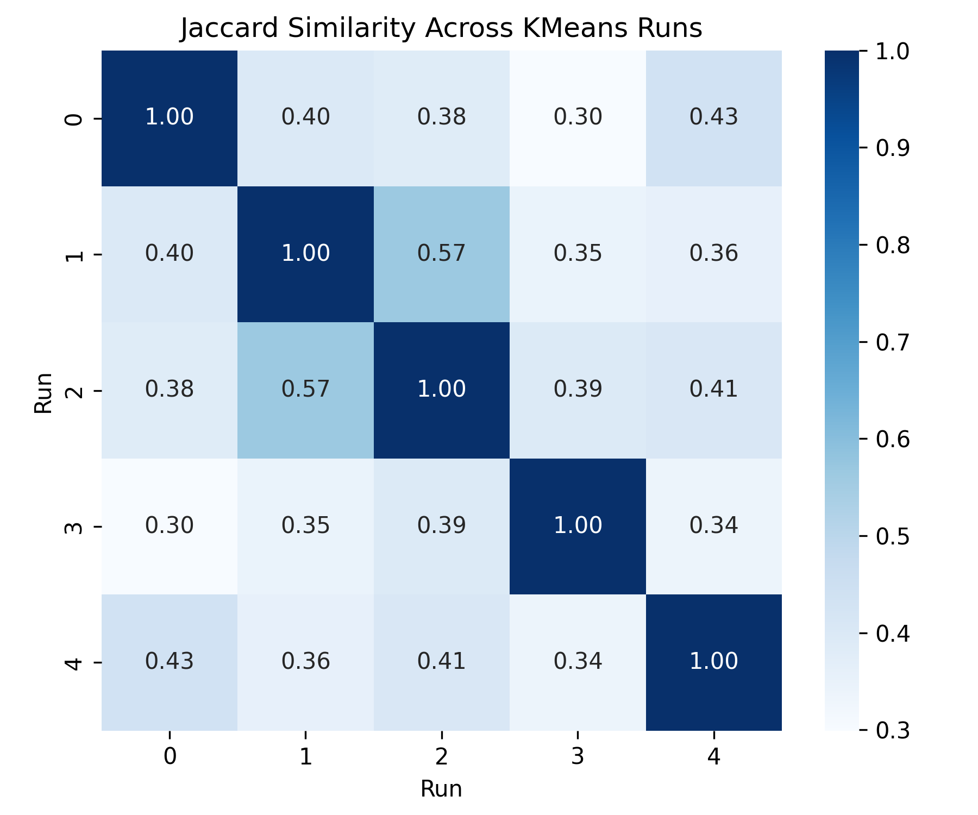
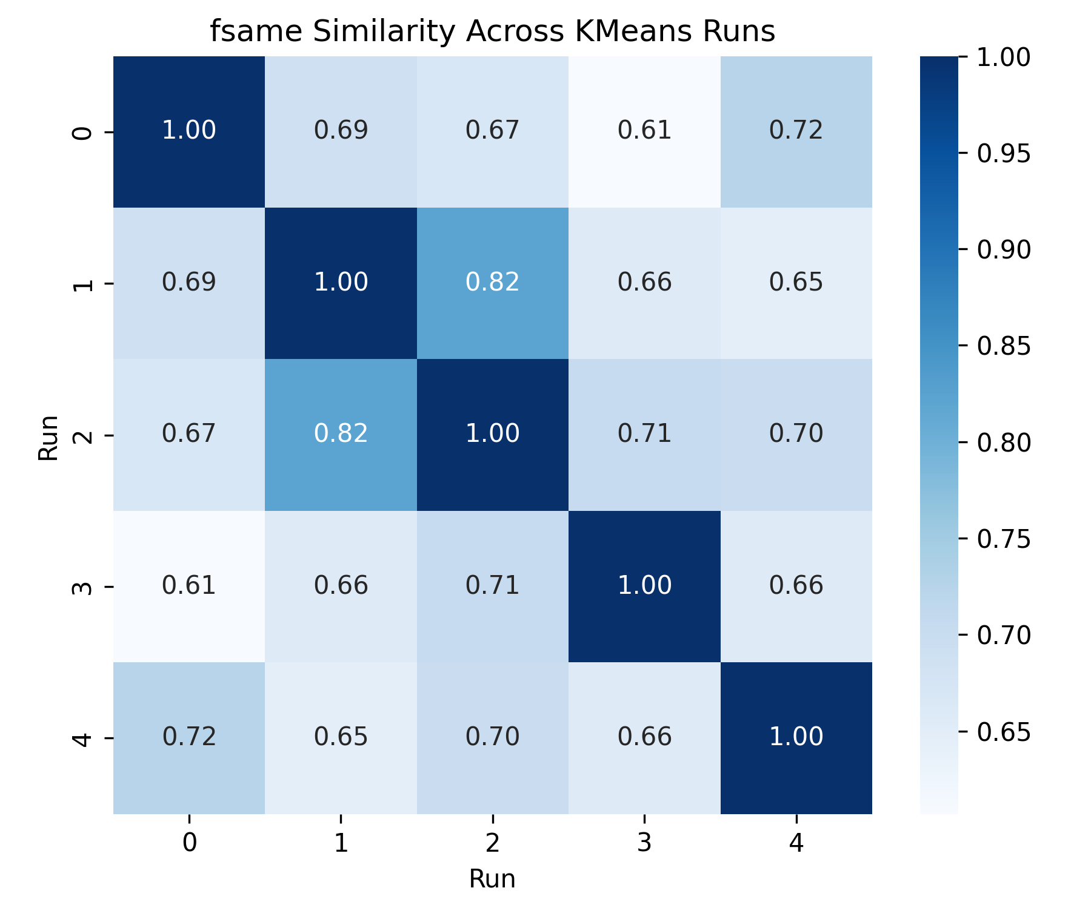
Results : Zachary
Zachary: Modularity : 0.3991 communities: 3 Runs 0–2: Perfect agreement (Jaccard = 1.00, fsame = 1.00), found the exact same two-community split. Run 4: Minor variation (Jaccard ≈ 0.68, fsame ≈ 0.90) – most nodes stay in their groups, but a few borderline nodes swapped. Run 3: Substantially different (Jaccard ≈ 0.45, fsame ≈ 0.76) – still two clusters of similar size, but many nodes moved across the divide. Between Modes (runs 3 vs 4): Low overlap (Jaccard = 0.35, fsame = 0.66), two alternate partitions disagree on a majority of node-pairs.
Co -authorship: Modularity : 0.6015 communities: 19 Low Jaccard Agreement (0.30–0.57): None of the five KMeans runs matched each other. Only 30–57 % of node-pairs that sit together in one run do so in another. High sensitivity to initialization of embeddings Moderate fsame Scores (0.61–0.82): Higher fsame values (~0.6–0.8) tell us the overall community sizes stay roughly consistent across runs. Means few big clusters and many small ones, but which nodes lands where shifts.

Slide 16
Deliverable 5: Temporal Communities
Datasets used: Email-EU-Core-Temporal and College_Msg
To track community evolution, we split data into 7-day windows, apply Louvain algorithm per window of information.
We extract temporal communities and visualize them.
Metrics used for visualisation are as follows:
Node Migration Rate: Measures how often nodes switch communities
b. Jaccard Similarity: Tracks overlaps between consecutive communities
c. Number of Communities: Indicates merges/splits over time

Slide 17
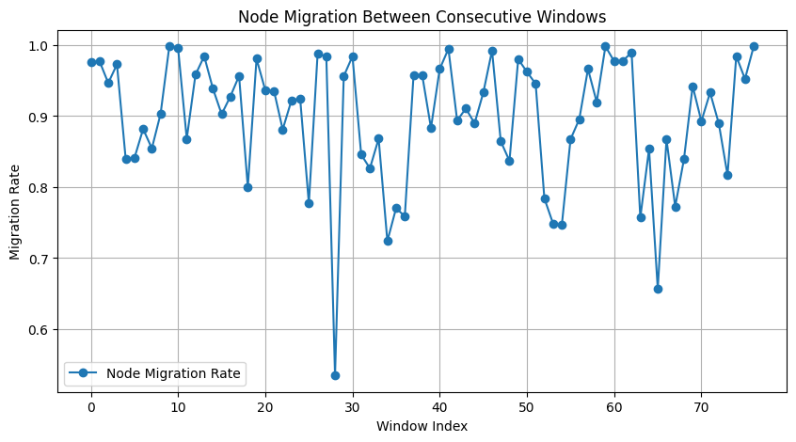
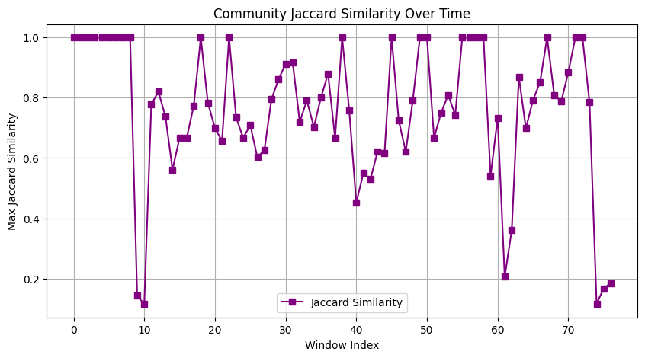
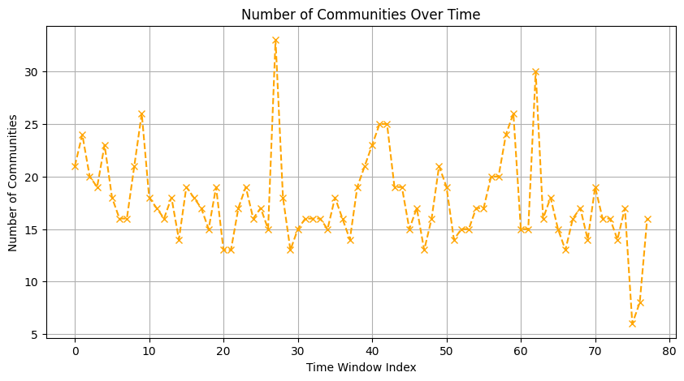
Results: Email-EU-Core-Temporal

Slide 18
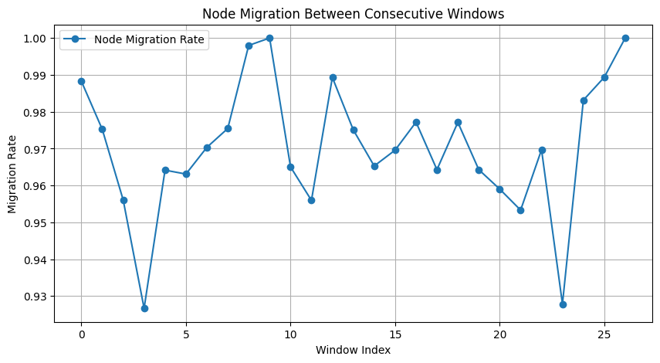
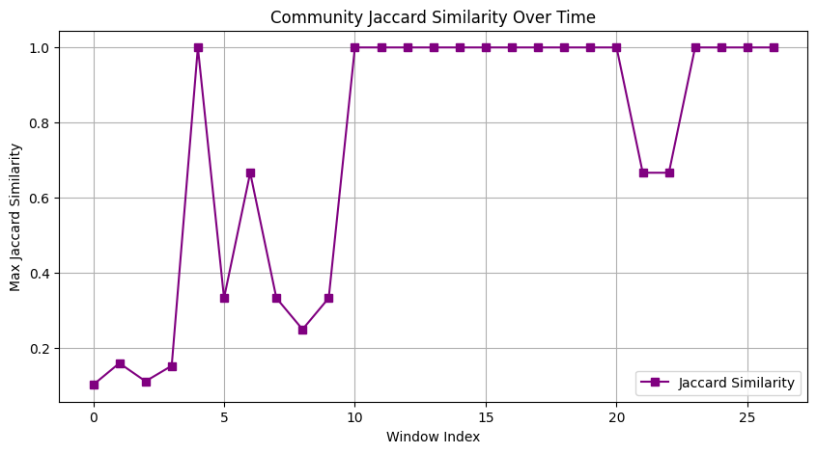
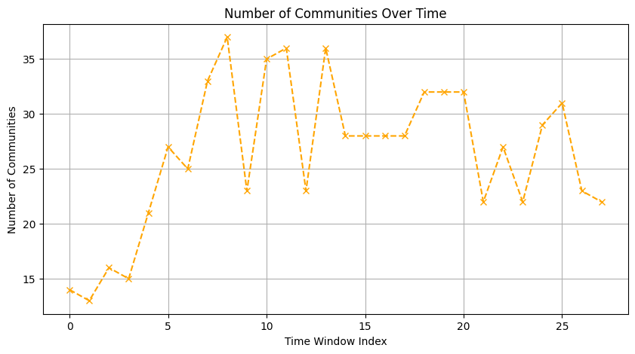
Results: College_Msg

